Slide 1
HEALTH CARE
FRAUD DETECTION
Deepika.A

Slide 2
Objective
Build a binary classification model based on the claims filed by the provider along with Inpatient data, Outpatient data, Beneficiary details to predict Healthcare Provider Fraud..
Outpatient Data : It consists of the claim details for the patients who were not admitted into the hospital, who only visited there.
Inpatient Data :It consists of the claim details for the patients who were admitted into the hospital.
Beneficiary Data : This data contains beneficiary details like DOB, DOD, Gender, Race, health conditions (Chronic disease if any), State, Country they belong to, etc.

Slide 3
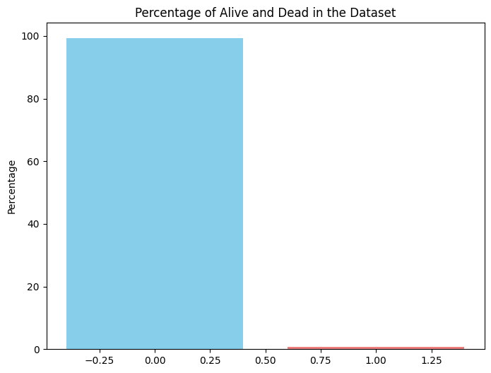
Observation
OBSERVATION
The above graph tells us that almost 99% of the beneficiaries are ALIVE and very small percentage of patients are DEAD. It would be good to see how much this feature has impact on the target.

Slide 4
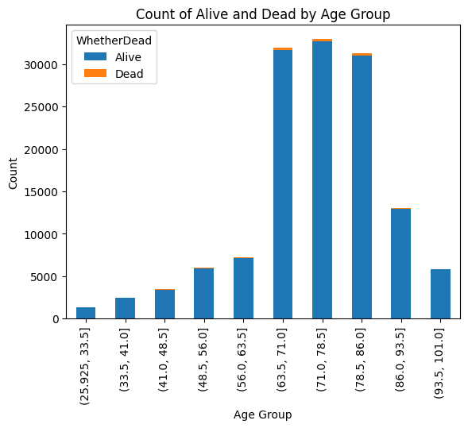
Observation
OBSERVATION
The graph shows the count of individuals who are alive and dead within different age groups.Notably, in the age group of 93.5 to 101.01 years,all individuals are alive with no deaths reported, which is unusual and suggests potential data anomalies or possible fraudulent claims.

Slide 5
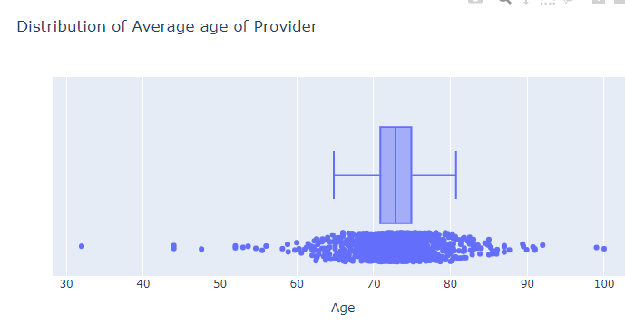
Observation
OBSERVATION
The idea behind this graph is that there might be a pattern like if the sum of patients age treated by a provider is very high or low then it might influence the fraud.

Slide 6
Steps
Data Merging:
Merged Inpatient and Outpatient data based on common columns.
Merged the resulting dataset with Beneficiary data using BeneID.
After merging all three dataset I got (135392 rows, 54 columns)
Encoding:
Used 'LabelEncoder' to encode categorical string columns in the final merged data.
Handling Missing Values:
Replaced all NaN values in the data with 0 using the fillna() method.
Correlation and Important Attributes:
Calculated the correlation matrix.
Extracted attributes with a correlation threshold greater than 0.0, identifying 53 important attributes.

Slide 7
Steps
Outlier Detection and Removal:
Used box plots to identify and count outliers and removed the attributes that have more outliers.
Data Scaling:
Standardized the data using StandardScaler, essential for distance-based algorithms like KMeans.
Feature Importance with PCA:
Applied PCA to identify feature importance by summing the absolute values of components.
KMeans Clustering:
Implemented KMeans clustering on the selected attributes to classify the claims as fraud or genuine.

Slide 8
Algorithm
Here I have used K-Means Algorithm .K-Means is a popular unsupervised machine learning algorithm used for clustering. It partitions a dataset into k clusters, where each data point belongs to the cluster with the nearest mean. The goal is to minimize the variance within each cluster.
Euclidean Distance Algorithm:
It is widely used in clustering and classification algorithms to compute the similarity or dissimilarity between data points.
d = √[(x22 – x11)² + (y22 – y11)²]

Slide 9
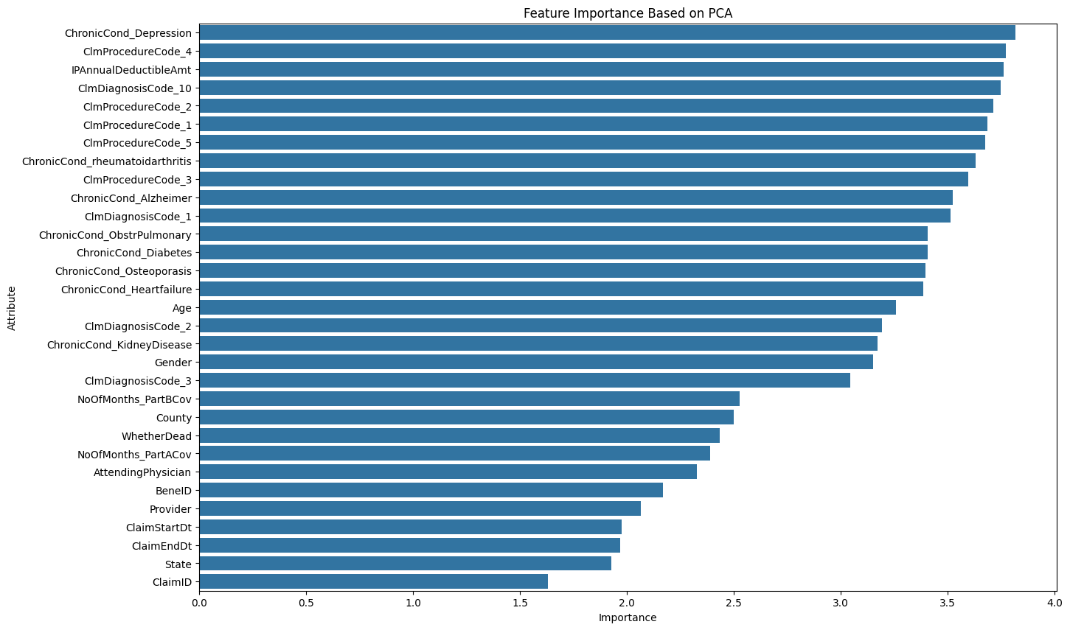
Influenced attribute

Slide 10
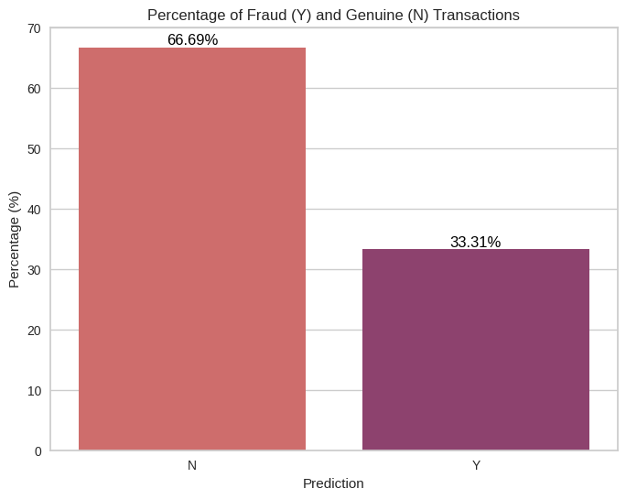
Prediction
Counts for fraud ('Y') and genuine ('N'):
Totally I have 135392 rows in which I got 90294 genuine ('N') and 45098 fraud ('Y')

Slide 11
Thank You

